Slide 1
Lesson on citations
13th June 2021

Slide 2
Lesson Objective
To show exemplar MLA referencing and citations

Slide 3
Why cite

Slide 4
What to cite

Slide 5
When to cite

Slide 6
When to cite

Slide 7
How to cite

Slide 8
How to cite

Slide 9
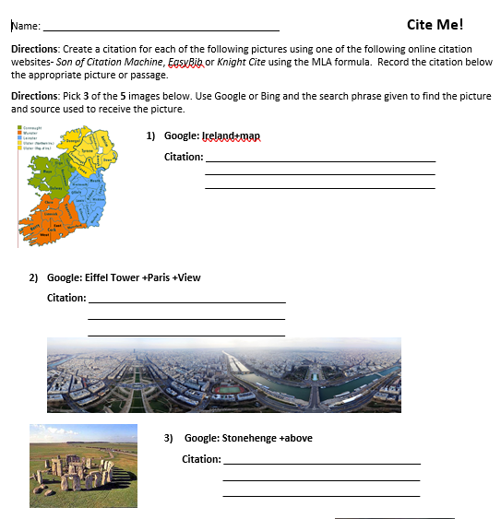
Practise 1

Slide 10
Practise 2

